Slide 1

What Mr. Spock would possibly say about modern unit testing: pragmatic and emotional overview

Slide 2
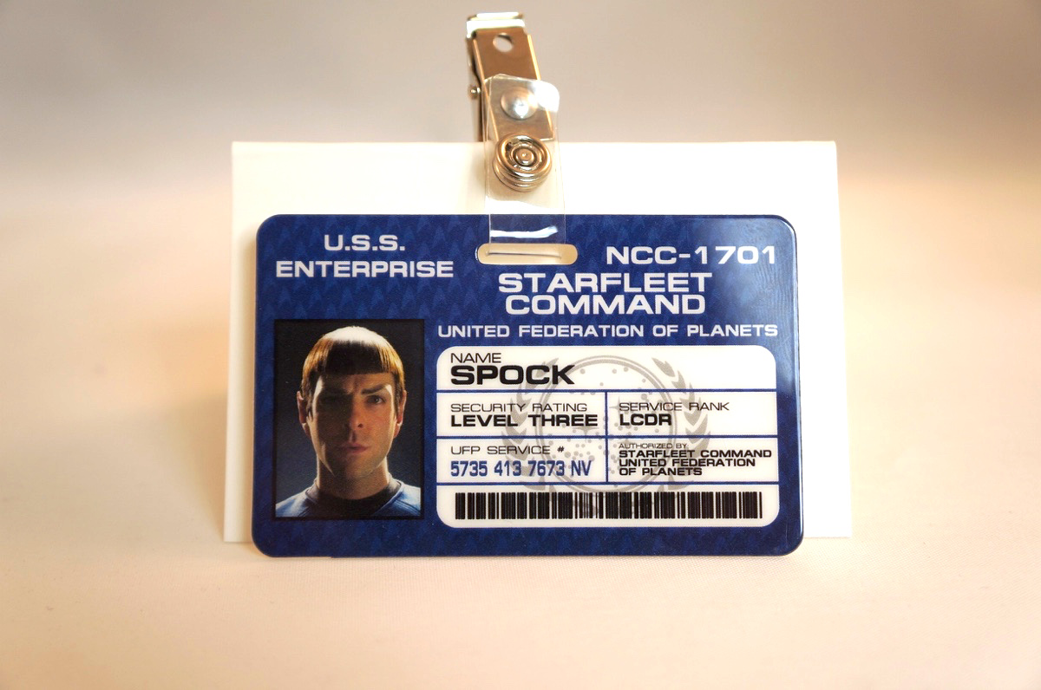
About me
Yaroslav Yermilov
Senior Software Engineer
EPAM Systems
Work on Big Data project
But responsible for test automation for
the last 2 years
Out of office is a big Groovy ecosystem fan
So the topic choice is obvious
https://twitter.com/yermilov17
https://www.facebook.com/yaroslav.yermilov
https://ua.linkedin.com/pub/yaroslav-yermilov/58/682/506

Slide 3
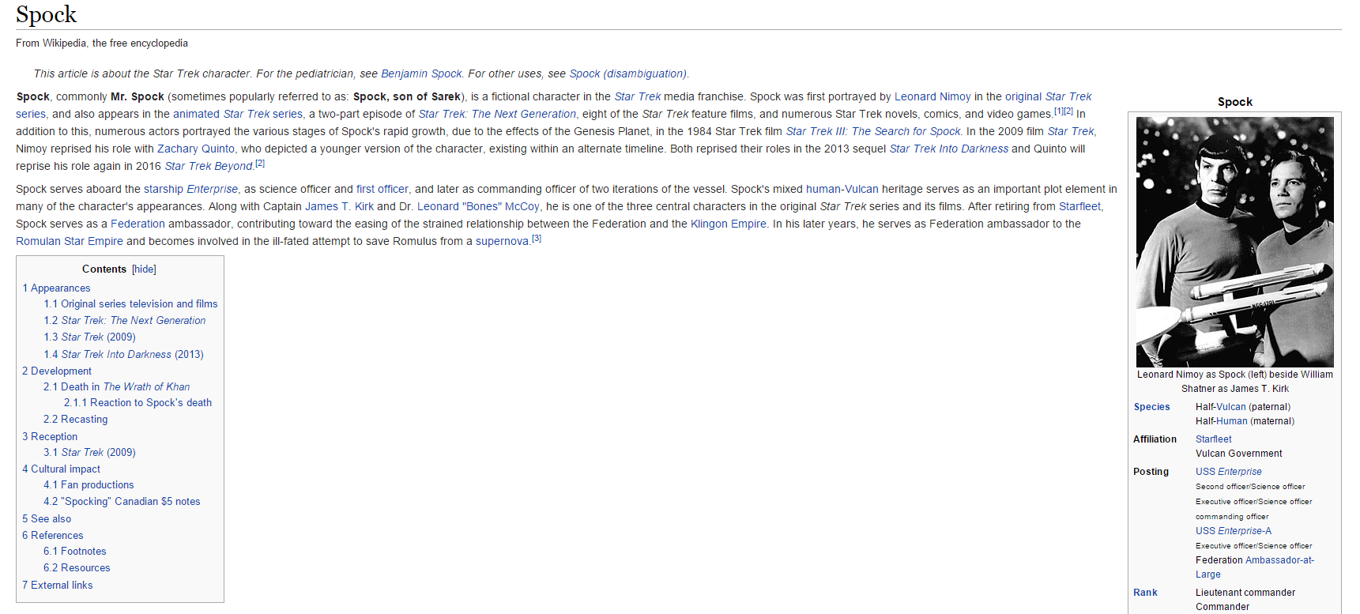
About Spock

Slide 4




Disclaimer

Slide 5

What’s the problem?

Slide 6

Better to test before going to production

Slide 7
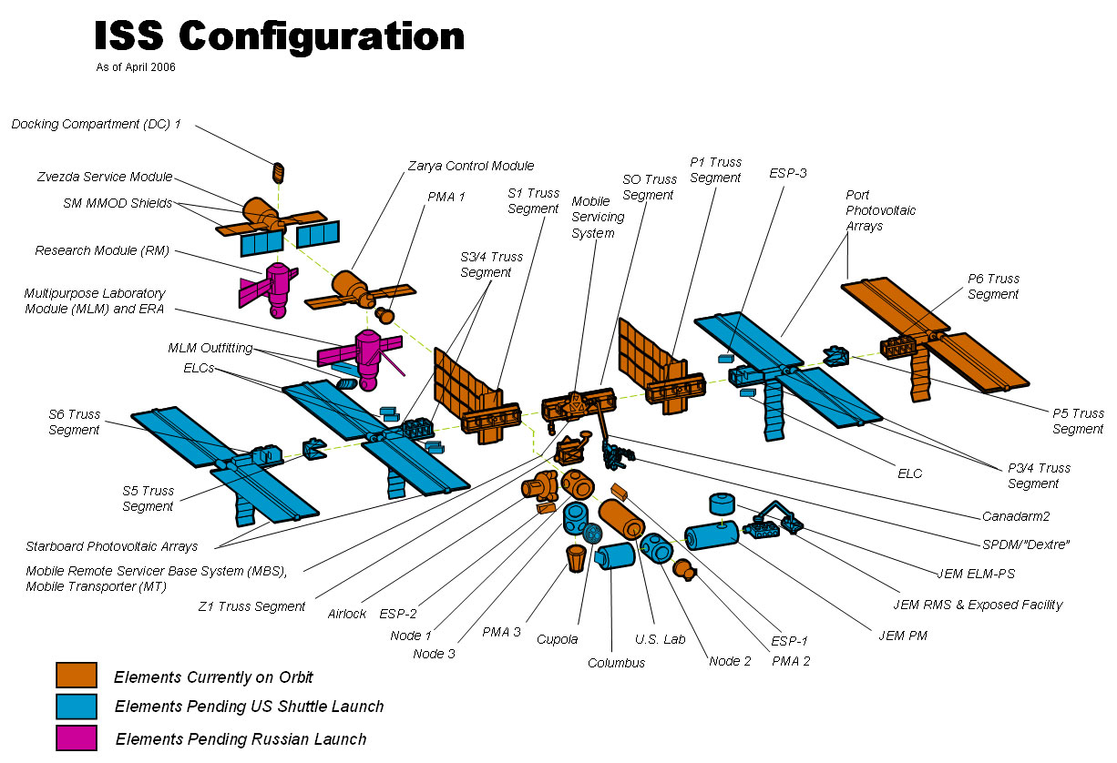
Firstly, to unit-test

Slide 8

So what?

Slide 9

JUnit?

Slide 10
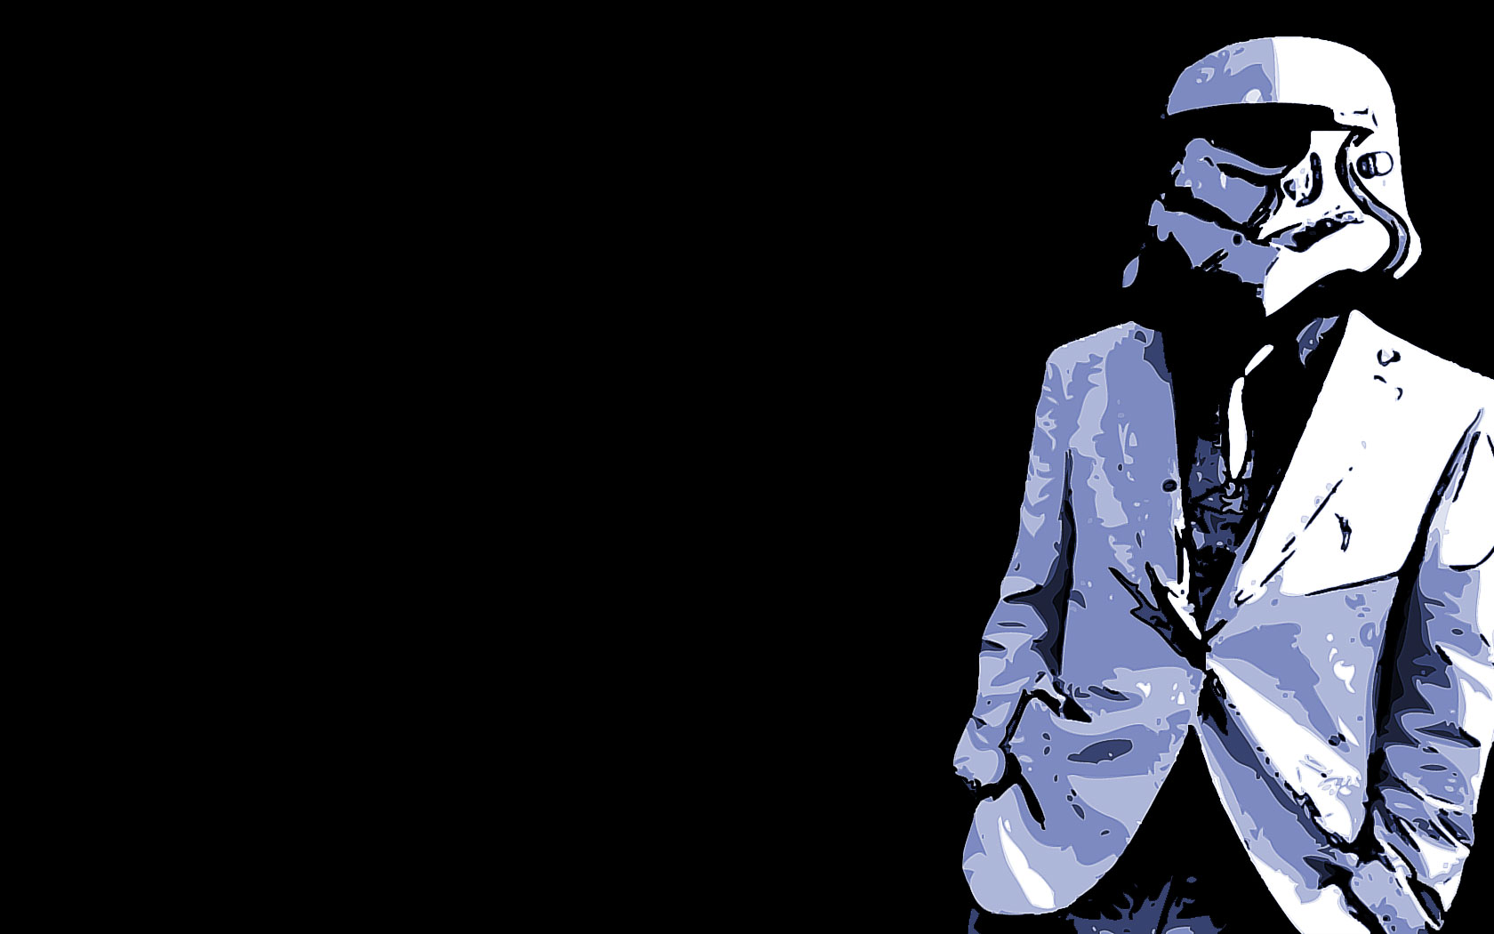
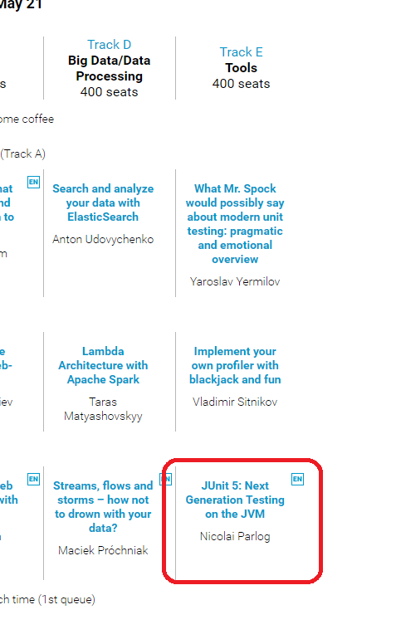
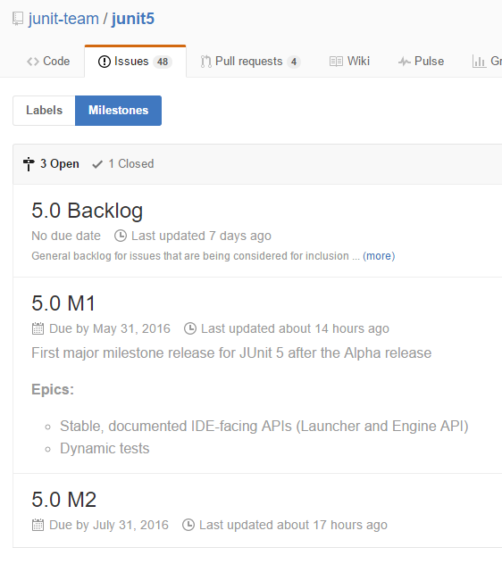
JUnit 5?

Slide 11

JUnit 3?

Slide 12

TestNG?

Slide 13

Unit testing framework on steroids?
Hamcrest
AssertJ
Google Truth
Mockito
PowerMock
JMockit

Slide 14

Spock?

Slide 15

Something odd?
Cucumber
J8Spec JGiven

Slide 16

Nothing?

Slide 17
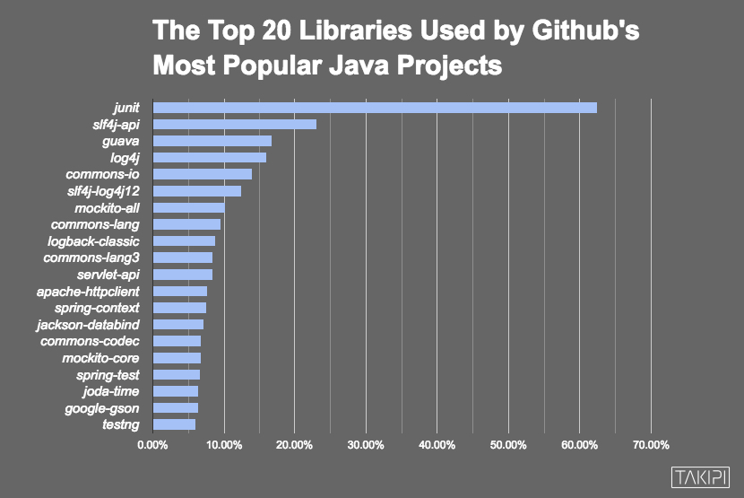

Slide 18

Automated testing
is a great concept

Slide 19

But have you ever felt like it’s frozen for the last years?

Slide 20
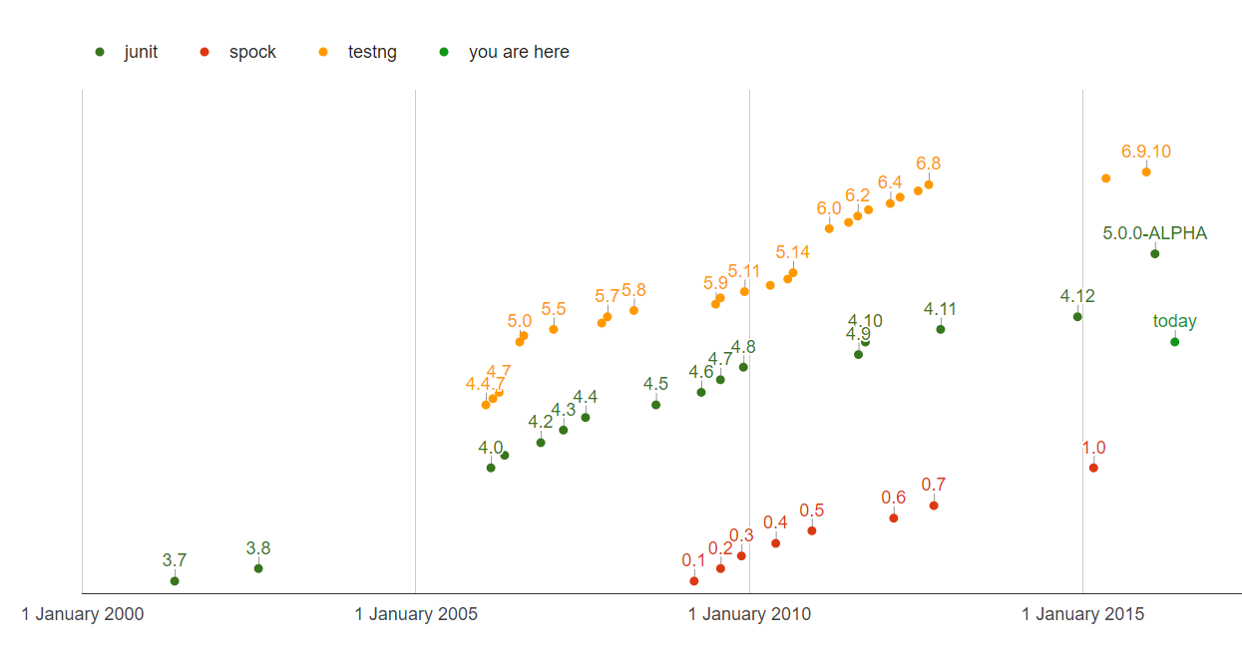
QUIZ: How many test framework releases we had since 2013?

Slide 21

So why don’t try Spock?

Slide 22

Spock is the next generation testing framework

Slide 23
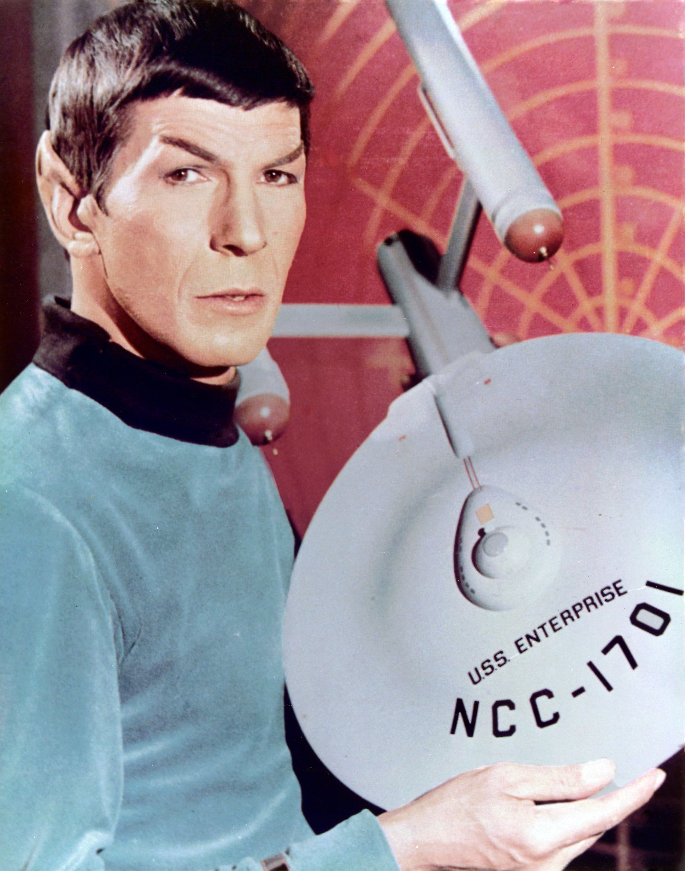
Spock is Enterprise ready

Slide 24
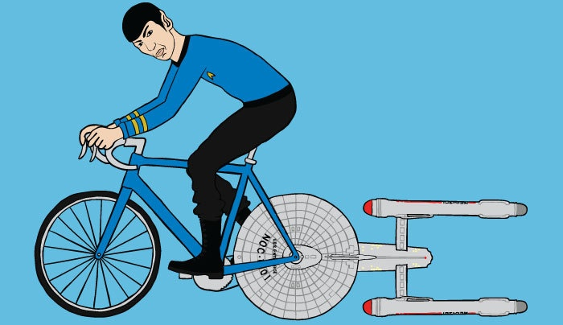
Let’s go!
https://github.com/yermilov/spock-talk

Slide 25

Episode I: Every journey starts somewhere

Slide 26
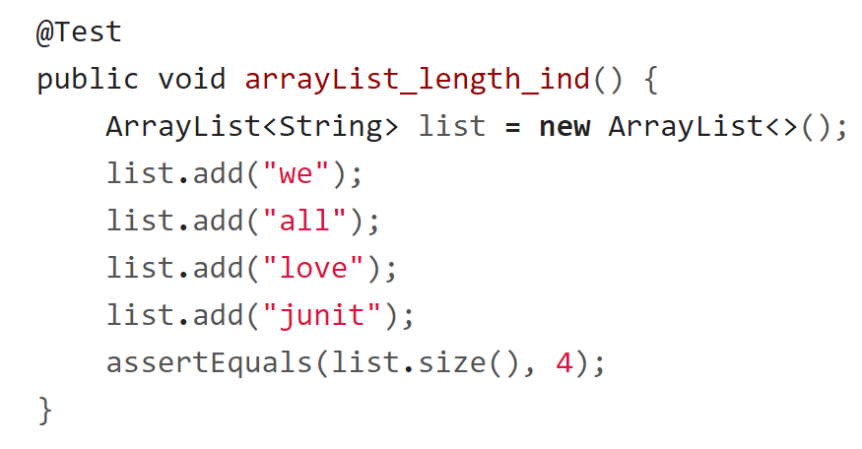
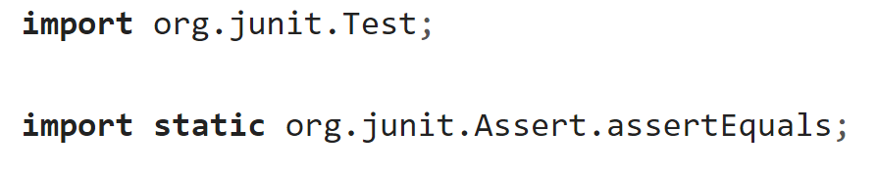
Episode I: Every journey starts somewhere

Slide 27
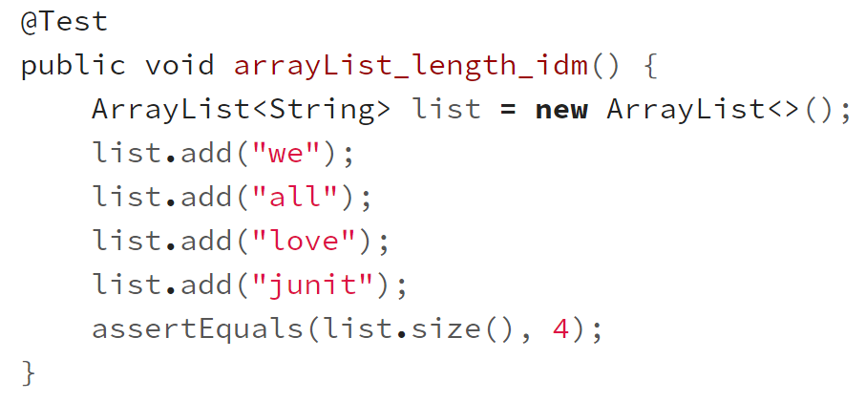
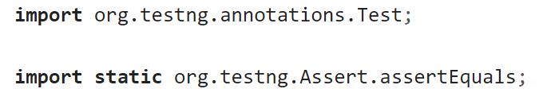
Episode I: Every journey starts somewhere

Slide 28
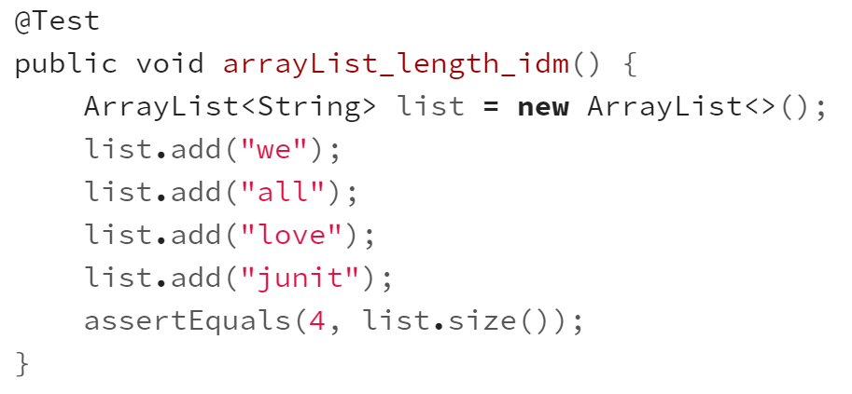
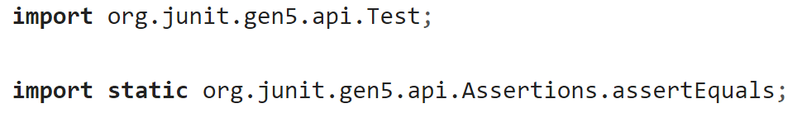
Episode I: Every journey starts somewhere

Slide 29
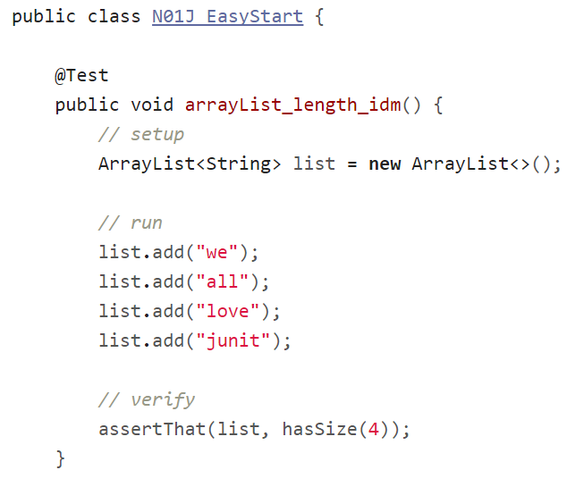
Episode I: Every journey starts somewhere

Slide 30
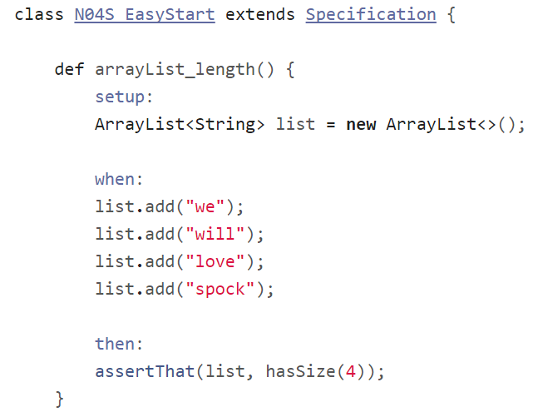
Episode I: Every journey starts somewhere

Slide 31
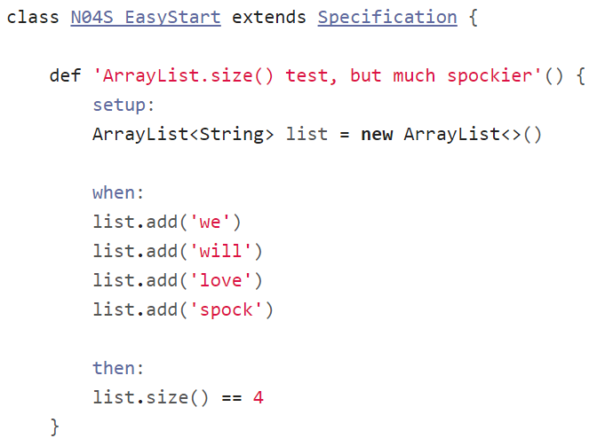
Episode I: Every journey starts somewhere

Slide 32
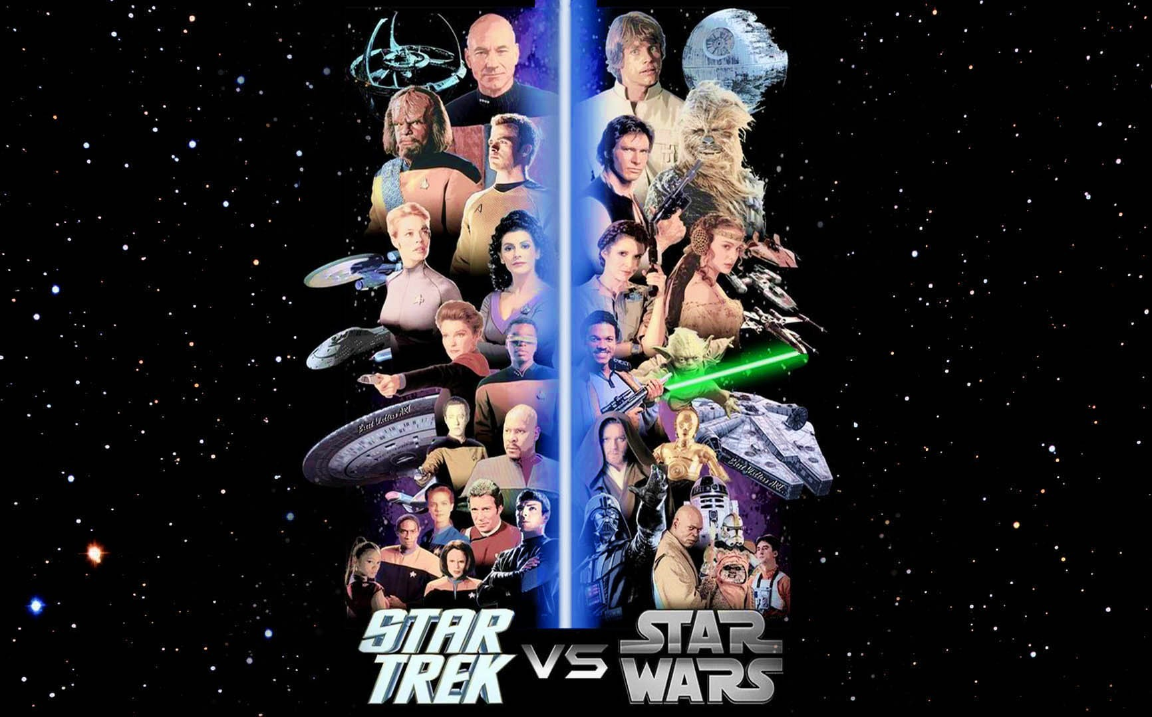
Episode II:
Assertions

Slide 33
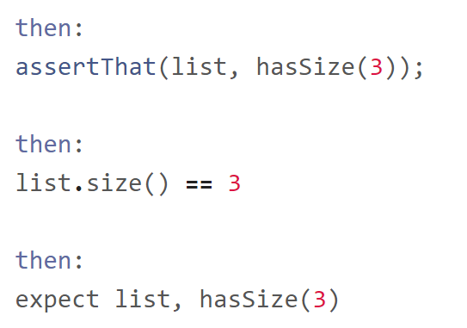
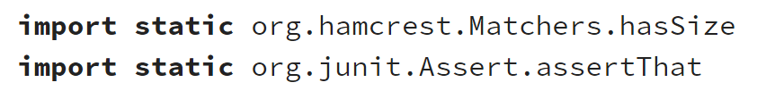
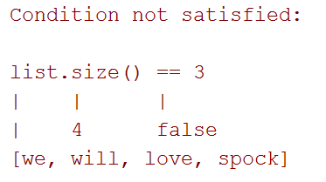
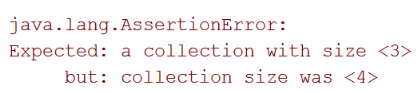
Episode II: Assertions

Slide 34
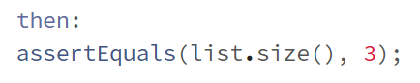
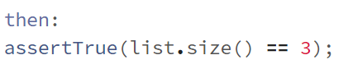
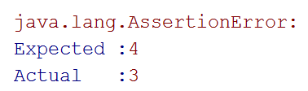
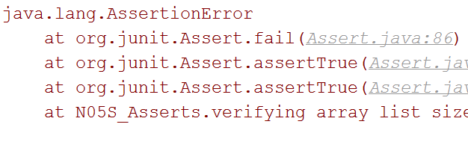
Episode II: Assertions

Slide 35
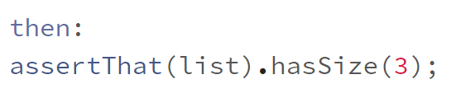
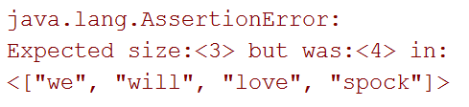
Episode II: Assertions

Slide 36
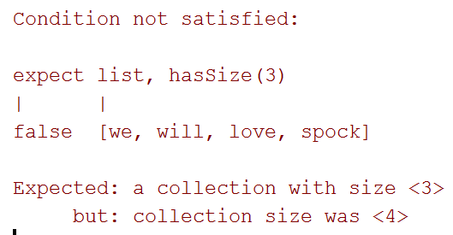
Episode II: Assertions

Slide 37
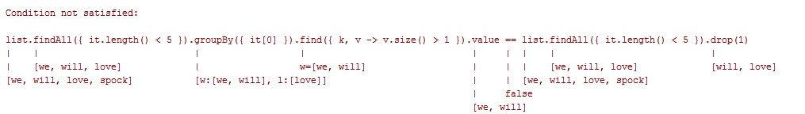
Episode II: Assertions

Slide 38
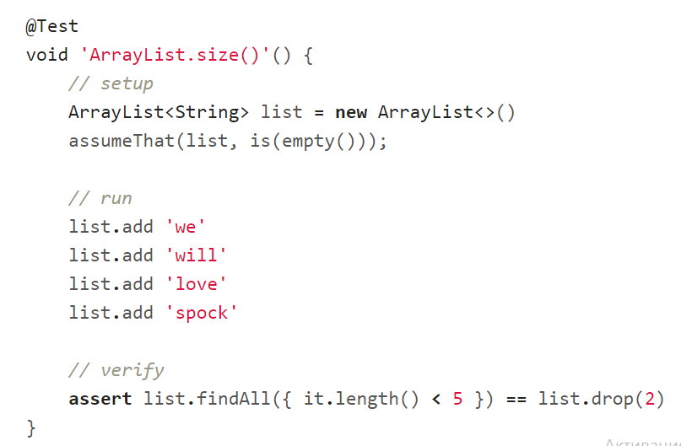
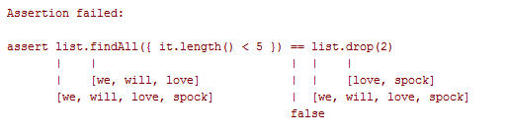
Episode II: Assertions

Slide 39
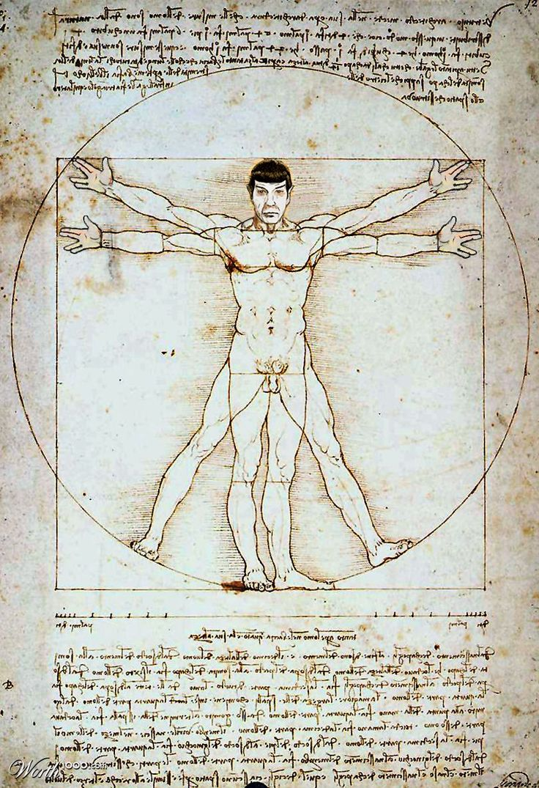
Episode III: Idiomatic Spock

Slide 40
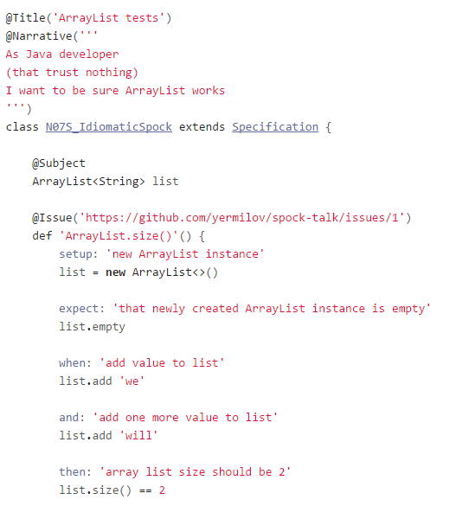
Episode III:
Idiomatic Spock

Slide 41
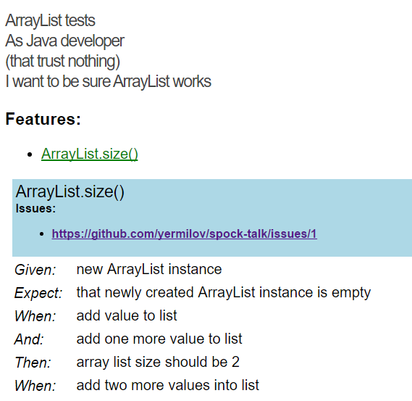
Episode III:
Idiomatic Spock
github.com/renatoathaydes/spock-reports

Slide 42
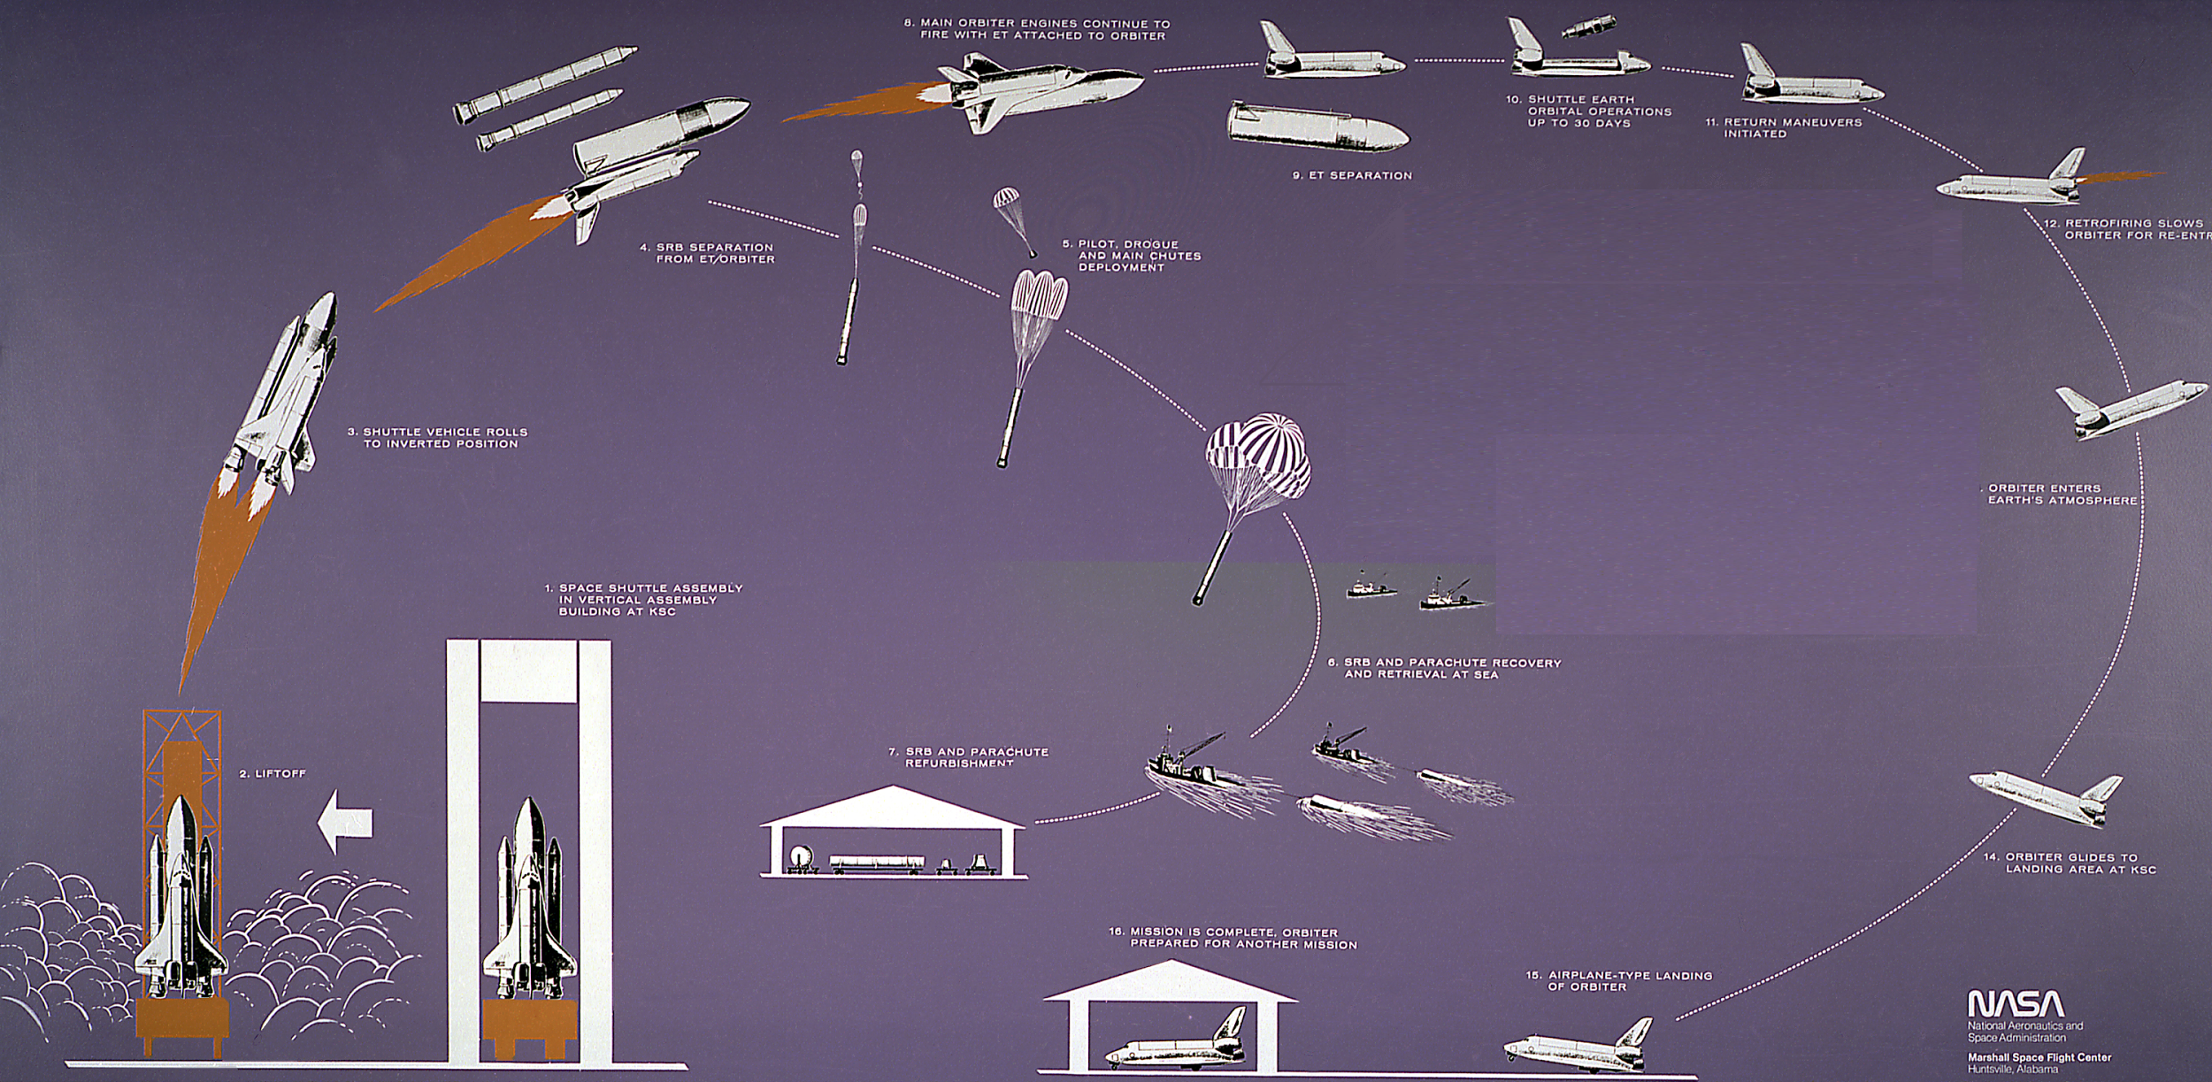
Episode IV:
Setup/Teardown

Slide 43
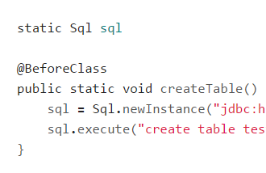
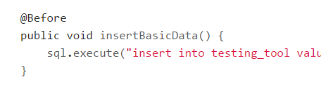
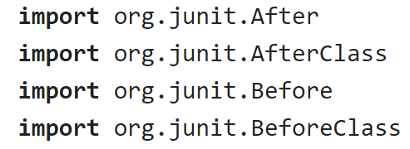
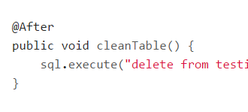
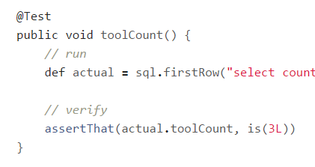
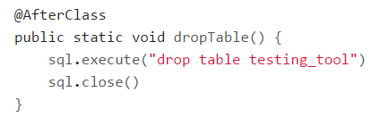
Episode IV: Setup/Teardown

Slide 44
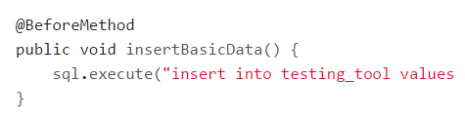
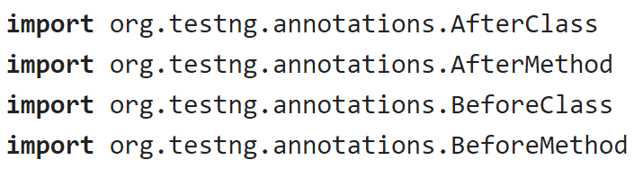
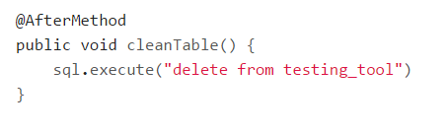
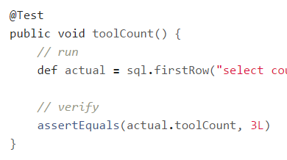
Episode IV: Setup/Teardown

Slide 45
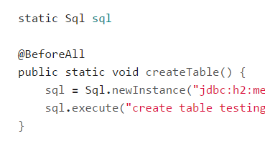
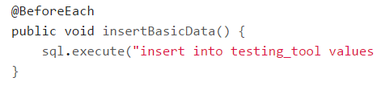




Episode IV: Setup/Teardown

Slide 46





Episode IV: Setup/Teardown

Slide 47


Episode IV: Setup/Teardown

Slide 48

Episode IV: Setup/Teardown

Slide 49


Episode IV: Setup/Teardown

Slide 50





Episode IV: @Shared or static?

Slide 51

Episode V:
Data driven test

Slide 52

Episode V: Data driven test

Slide 53

Episode V: Data driven test

Slide 54

Episode V: Data driven test

Slide 55

Episode V: Data driven test

Slide 56

Episode V: Data driven test

Slide 57

Episode V: Data driven test

Slide 58

Episode V: Data driven test

Slide 59

Episode V: Data driven test

Slide 60

Episode VI:
Exceptions

Slide 61

Episode VI: Exceptions

Slide 62

Episode VI: Exceptions

Slide 63

Episode VI: Exceptions

Slide 64

Episode VI: Exceptions

Slide 65

Episode VI: Exceptions

Slide 66

Episode VI: Exceptions

Slide 67

Episode VI: Exceptions

Slide 68

Episode VI: Exceptions

Slide 69

Episode VI: Exceptions

Slide 70

Episode VII:
Mocks,
Stubs,
Spies

Slide 71


Episode VII: Mocks, Stubs, Spies

Slide 72

Episode VII: Mocks, Stubs, Spies

Slide 73


Episode VII: Mocks, Stubs, Spies

Slide 74

Episode VII: Mocks, Stubs, Spies

Slide 75

Episode VII: Mocks, Stubs, Spies

Slide 76


Episode VII: Mocks, Stubs, Spies

Slide 77

Episode VII: Mocks, Stubs, Spies

Slide 78

Episode VII: Mocks, Stubs, Spies

Slide 79

Episode VII: Mocks, Stubs, Spies

Slide 80

Episode VII: Mocks, Stubs, Spies

Slide 81

Episode VIII: Time travel

Slide 82

Episode VIII: Time travel

Slide 83
Episode VIII: Time travel

Slide 84


Episode VIII: Time travel

Slide 85

Episode VIII: Time travel

Slide 86


Episode VIII: Time travel

Slide 87

Episode VIII: Time travel

Slide 88


Episode VIII: Time travel

Slide 89

Episode VIII: Time travel

Slide 90

Episode VIII: Time travel

Slide 91

Episode VIII: Time travel

Slide 92

Episode IX:
Test control

Slide 93



Episode IX: Test control

Slide 94

Episode IX: Test control

Slide 95
Episode IX: Test control

Slide 96

Episode IX: Test control

Slide 97

Episode IX: Test control

Slide 98

Episode IX: Test control

Slide 99

Episode IX: Test control

Slide 100

Episode IX: Test control

Slide 101

Episode IX: Test control

Slide 102


Episode IX: Test control

Slide 103

Episode IX: Test control

Slide 104



Episode IX: Test control

Slide 105

Episode X: Encore

Slide 106

Episode X: Encore

Slide 107

Episode X: Encore

Slide 108

Episode X: Encore

Slide 109

Episode X: Encore

Slide 110
Episode X: Encore

Slide 111

Episode X: Encore

Slide 112

Episode X: Encore

Slide 113

Episode X: Encore

Slide 114

Why one should use Spock?

Slide 115

Concise syntax

Slide 116

Language for testing instead of testing struggling language

Slide 117

Clear test structure

Slide 118

Code and reports readable for everyone

Slide 119

Powerful built-in features

Slide 120

Extensions

Slide 121

Useful for unit, integration and functional tests

Slide 122


Behaves as one more JUnit runner

Slide 123

Works for both Groovy and Java

Slide 124

Why one should not use Spock?

Slide 125

JUnit/TestNG has 90% similar/imitable features

Slide 126



Spock lost its lead developer

Slide 127

When one can use Spock?

Slide 128

Your team is ready to make one step forward

Slide 129

You are about to start new project

Slide 130

You want to cover legacy project with unit tests

Slide 131

You want to introduce functional testing in your project

Slide 132

What’s next?
http://spockframework.github.io/spock/docs/1.0/index.html
http://meetspock.appspot.com/
https://github.com/spockframework
Just use it in your projects and enjoy!

Slide 133

Thanks!

